Slide 1



WV High Altitude Balloon Mission 2022 - 2025
WV Space Grant Consortium (WVSGC)
Trinity Christian School (TCS)

Slide 2
Overview
Mission Overview
Team
Mission Goals
Mission Concept
Team Responsibilities
Opportunities to Participate

Slide 3
Mission Overview
YouTube Video: https://www.youtube.com/watch?v=CGcuzZx8ZvE
Montana Space Grant Consortium (MSGC) at Montana State University leads the National Eclipse Ballooning Project (NEBP)
Has had successful flight campaigns during the 2017, 2019, and 2020 total solar eclipses
This new mission is focused on the 2023 annular and 2024 total solar eclipses.
The Nation-wide mission will basically entail:
At sites along the eclipse path, student teams will use innovative high altitude balloon systems to live stream video to the NASA eclipse website, observe in situ perturbations in atmospheric phenomena, and conduct individually designed experiments.
The Nation-wide mission consists of 70 teams:
The 70 teams are divided into ten pods to facilitate effective education.
NEBP will provide a learning environment that uses evidence and equity-based practices to make certain the 1,000+ participants are (and feel) supported, engaged, and valued.
In addition, NEBP will provide infrastructure tools and best practices to help participating institutions build collaborations that could continue far beyond the scope of this project.

Slide 4
WV High Altitude Mission – Part of NEBP
WVSGC and TCS was selected as 1 of the 70 teams building, launching, operating, and recovering engineering track high altitude balloons
Mission Launch
Annular Eclipse - October 14, 2023
Total Solar Eclipse - April 8, 2024
= Launch Sites
Overarching Goal: Design, develop, test, deploy, and recover stratospheric ballooning systems.
The team will fly large balloon platform capable of lifting 12 pounds of student-designed and -built payloads to 80,000 – 100,000 feet, streaming live video and collecting critical data along the way.
Typical engineering platform experiments include atmospheric measurements, photography, cosmic radiation measurements, and space technology proof-of-concept hardware.

Slide 5
Current Team Members
Team Mentors:
Candy Cordwell – Assistant Director WV Space Grant Consortium
Marcus Fisher – NASA GSFC Senior Fellow and Trinity Christian School (TCS) STEM Teacher
Engineering Team:
TCS High School STEM Club
Students from WVU, Glenville State, and WV State
Goal is to have each county from WV represented
Computer Science Teachers Association (CSTA) - used to recruit schools across the state
Girls that code from each county
Classroom / Laboratory from TCS is the build location

Slide 6
Mission Goals
To enable inclusive STEM education, engage the public and K-12 students getting them excited in the engineering and sciences of HAB
State-wide campaigns to get diversity of students participating in mission patch design and outreach materials
State-wide campaign to get WV citizens submit their names to fly on board the HAB during the eclipse
Monthly knowledge-sharing events across the state of WV regarding engineering and sciences of HAB.
Work with each of the 57 K-12 school districts in WV to participate in outreach, data analysis, or as part of the engineering team
To advance learners’ understanding of the process of science and engineering
High school classes would be a year-long class (Systems engineering focused on cyber-security and HAB)
University class would be one-semester classes (Systems engineering focused on cybersecurity and HAB)
To create, enhance, and sustain networks and advance the engineering of real-time systems
Outreach
Using the success model of the statewide SPOT program, we will enhance the public’s understanding and general knowledge about NASA and high-altitude balloon systems through public seminars and workshops.
Collaborate with Industry to fly experiments on HAB
Develop common platform, system model and flatsat for reusability on future flights
Engineer high altitude balloon system that provides real-time video of solar eclipses on NASA websites

Slide 7
WVSGC-TCS: Mission Concept and Activities
Develop High Altitude Balloon Systems and Ground Stations that provide real-time video of solar eclipses to NASA websites (see next slide)
Conduct monthly lunch and learns broadcasted across state
Conduct state-wide challenge for WV’s mission logo
Conduct state-wide initiative to have public submit their names to fly on board
Conduct outreach across the state regarding HAB and eclipse science
Develop High School engineering class in cybersecurity and HAB
Develop University class in systems engineering with HAB as project
Develop System model and software-only simulation of HAB system
Recruit schools across WV to participate:
Participation can be in various ways (i.e., outreach, data analysis, payload development)

Slide 8
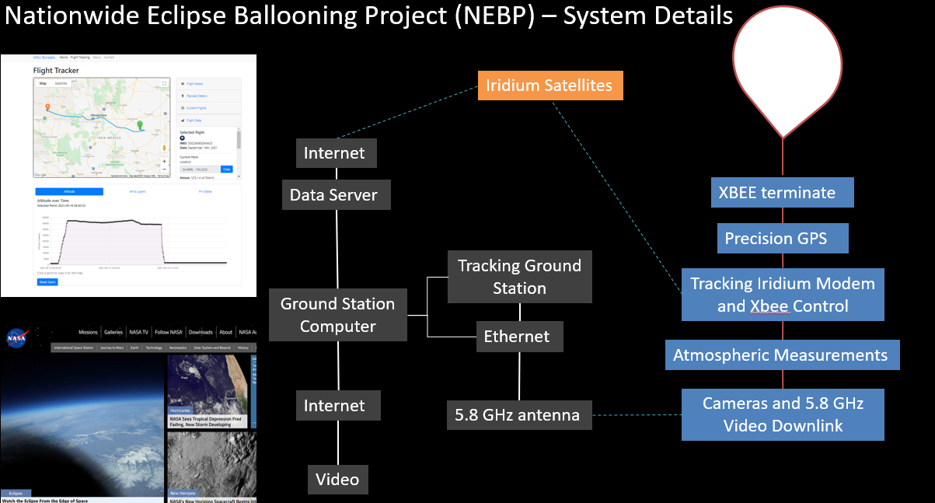
High Altitude Balloon (HAB) System - Concept
Parachute

Slide 9
Current Responsibilities
HAB System
WVUSGC
TCS
WVU ARC
Balloon
Parachute
xBee cut away
GPS
Tracking Modem
Camera & 5.8 GHz Video Downlink
Ground System
NASA Data Server
Tracking Station & 5.8 GHz Antenna
Ground Station
Atmospheric Measurement
Payload A
Payload B
TCS
?
Initiative Leads
Project Management (WVSGC and TCS)
State-wide mission logo (Glenville State)
State-wide submitting names (Glenville State)
Outreach across state in HAB and Science (Glenville State)
Monthly Lunch & Learns (TCS)
Mission Web Site & Blogging (WVSGC)
Summer Workshop (WVSGC & TCS)
High School Class Development (TCS)
University Class Development (WVU)
System Model
FlatSat
Software Only Simulation
TCS

Slide 10
Opportunities To Participate:
October 2023 Eclipse Flight
One Payload Spot
Second flight system may fly – 6 possible payload opportunities
April 2024 Eclipse Flight
One Payload Spot
Second flight system – 6 payload opportunities
Initiatives:
Offer High School class in computer engineering 2023-2024 academic year
Electronics, Arduino, Linux, Raspberry Pi, Pi and Electronics - Material will be provided along with some hardware
Summer Workshop at Trinity Christian School (June 26-30, 2023)
Explore Amazon Ground Services to investigate its use as a ground station
Conduct outreach across the state (e.g., Balloon projects, parachute projects, Arduinos, etc.)
Data Analysis on post flight data (e.g., data sciences class and/or machine learning class)
Design Mission Logo
Payload Ideas:
Basic weather station package (e.g., middle school team)
Artificial Intelligence (AI) generated code
Image processing investigations and AI/ML
Quantum Experiment
Near Infrared Camera
Glider that returns to launch site
Long duration flight
Electron Density

